Slide 1
Filtration

Slide 2
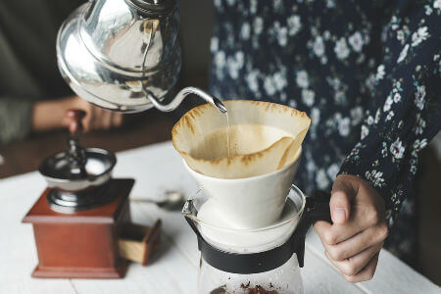
By the end of this lesson you should be able to:
Define the terms filter, filtrate and residue.
Explain how filtration works.

Slide 3
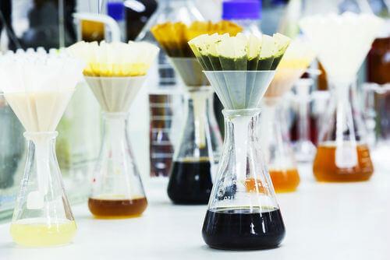
Straining is useful when a suspension contains large solids that you need to separate.
But what if you want to separate out smaller solids?
We use a method called filtration to remove small solids from mixtures.

Slide 4
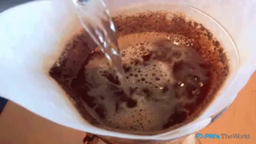
Filtration involves passing a suspension through a filter, which is a material that has lots of very small holes.
The tiny holes allow only some substances to pass through and not others. For example, a coffee filter lets water pass through, but keeps the coffee grounds separate.

Slide 5
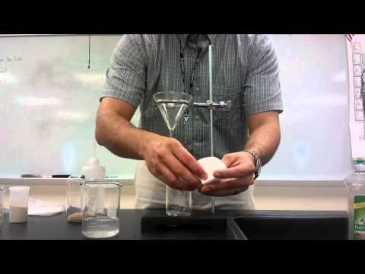

Slide 6
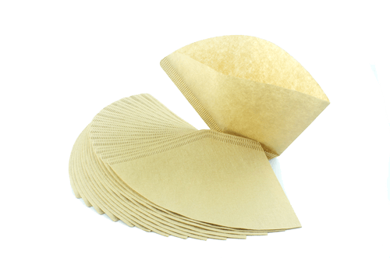
In the lab, we filter using filter paper.
It has tiny holes that let most liquids through, but not solids.

Slide 7
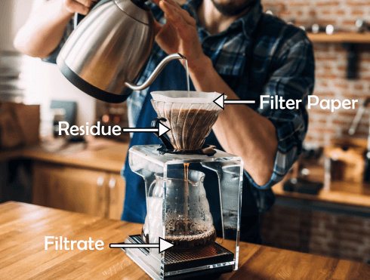
Solid particles cannot pass through the holes and are called residue.
Liquid can pass through the filter paper; this is called the filtrate.
This method of separation is useful because both the residue and filtrate can be saved and used elsewhere.

Slide 8
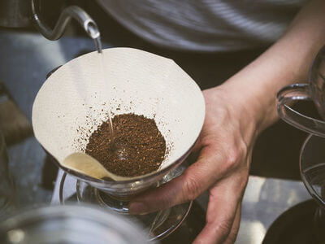
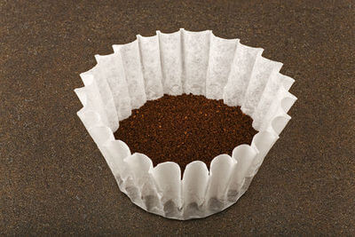
Filter paper is supplied in a circular shape, so it usually needs to be folded into a cone to be used for filtering.
It may seem easiest to just stuff the paper into a filtering cone, but folding provides a greater area for the liquid to filter out.
There are two folds we will look at - conical and fluted.

Slide 9
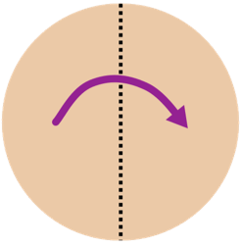
A conical fold makes a cone shape, like an ice cream cone.
To make this shape, follow these steps.
1. Fold the filter paper circle in half.

Slide 10
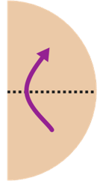
2. Fold this in half again to make a quarter-circle shape.

Slide 11
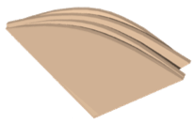
3. Look at the side, where you will see two holes.
Open one of them out.

Slide 12
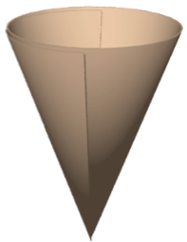
You will now have a cone that has one thick side where the folded paper is.
This is conical filter paper, which is the usual fold you will use to filter with.

Slide 13

The other way to fold filter paper is the fluted fold. This is described below:
1. Take the filter circle and fold it in half twice to get the quarter-circle shape.
2. Fold it in half again, then open the paper up to the half circle. It should make a zig-zag shape.

Slide 14
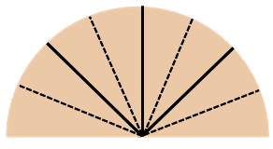
3. Fold each segment of the paper into half again.

Slide 15
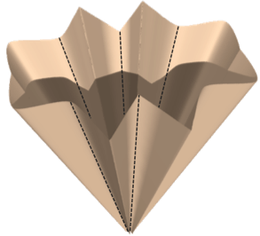
4. Open the paper out.
You should have a cone with a large number of folds in it.

Slide 16
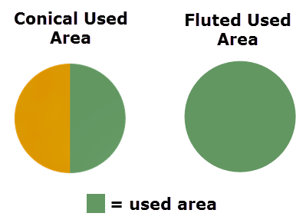
This pattern may be complicated to make, but it increases the amount of filter paper surface that is in contact with the liquid.
This means there are more holes for fluid to escape from and makes the filtration rate quicker.

Slide 17
